Slide 1
iprs & food systems, challenges to humanity and shocks
Mariam Mayet
African Centre for Biodiversity, June 2020

Slide 2
Key issues
IPRS –Plant Variety Protection (PVP) based on UPOV 1991 and patents on genetic resources and associated TK –fundamental to architecture of industrial agriculture:
Depletion of genetic resources/biodiversity/ecosystems
Corporate concentration
Technological lock ins
Criminalising farmers’ rights and farmers’ seed systems, human rights violations (right to food etc.)
Where are we internationally on the question of farmers’ rights?
Shocks –what is emerging and converging and work of social movements during COVID and beyond

Slide 3
UPOV 1991 style PVP systems and destruction
UPOV is part of the global architecture of intellectual property laws, that provide for exceptionally strong breeders’ rights, that support and entrench current corporate-industrial food and monoculture agricultural systems.
This system is based on the commodification of nature and knowledge, and has caused loss of agricultural biodiversity and great destruction to the earth’s life-supporting systems.
Strongly being pushed at both national levels, and through regional harmonisation efforts and trade agreements including at continental level

Slide 4
Corporate concentration and oligopolies
IPR regimes over plant genetic resources for food and agriculture and associated traditional knowledge, both patents and plant variety protection, incentivises and entrenches corporate concentration and oligopolies in the seed sector and also in the agro chemical sectors. ( Dow/DuPont, ChemChina/ Syngenta, Bayer/ Monsanto.
Power and control characterised by characterised by a dependence on proprietary seed, including and especially genetically modified (GM) seed and agrochemical inputs.
Too big to fail

Slide 5
Technological lock ins and squeezing humanity
Control by corporates of global productive and food systems placed us all on a narrow corporate controlled technological path:
Control over research and development and “innovation”, seeds to be planted, food to be eaten, technologies and chemicals to be used
No choice, further entrenching highly processed, standardised, input-intensive staple crop varieties, to the detriment of traditional foods, resulting in the loss of nutrients and agricultural diversity
digitalisation of agriculture and the role played by the agricultural machinery sector;

Slide 6
Criminalising Farmers’ rights
PVP regimes based on UPOV 1991 formulated for benefit of corporate seed producers and breeders, pave way for the private sector’s domination of seed production and the free trade in corporate so-called “improved seed”
Totally utterly undermines farmers’ rights and criminalises age-old practises of seed exchange and sale
Deskilling of farmers, farmers as passive consumers and price takers
APREBES Human Rights Assessment of UPOV points to causal link between reduced access by farmers to seed and undermining of the right to food
Internationally, little to no progress on farmers’ rights

Slide 7
Challenges
Shocks need to be addressed. And these must be multiple shocks.
Intervening issues, seed aid, food aid the package of farmers’ rights of seed must be linked with the bundle of other rights (UNDROP)
Here there are the usual linkages with water, biodiversity, land but there also other rights. Shocks and how we define these beyond natural disasters e.g. markets shocks, price shocks that impact on farmers, technological locks ins and the suicides in many countries the knock on effects for society and the burdens on women.

Slide 8
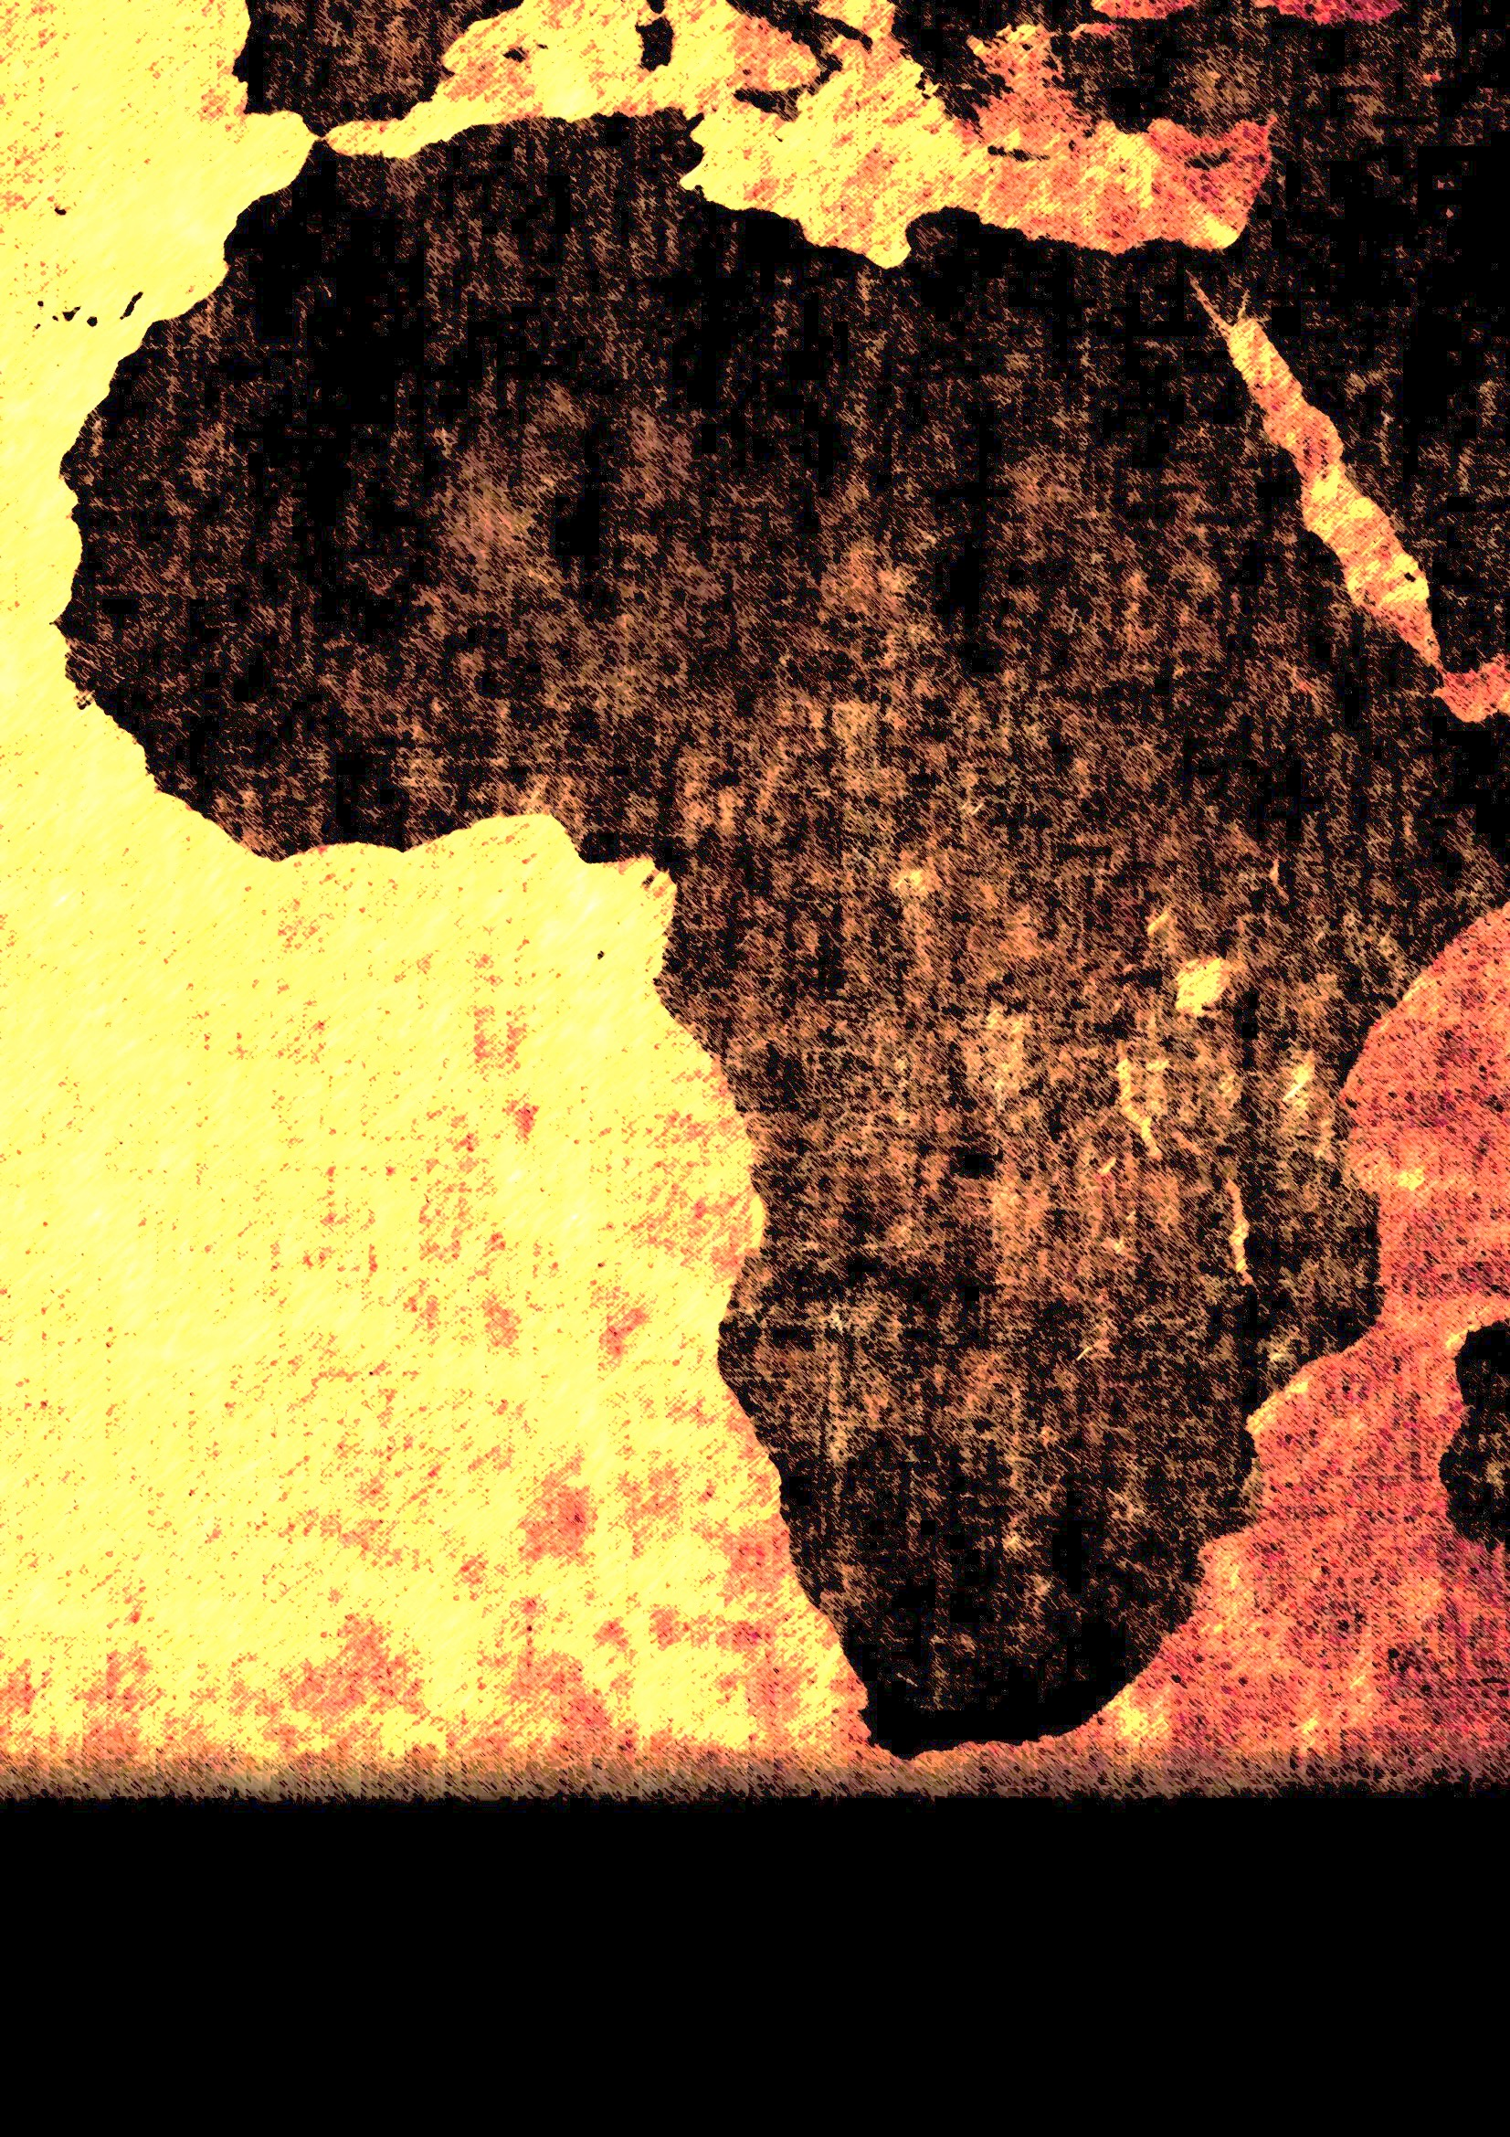
PANDEMIC
Corporate response:
Keep trade open –and increasingly narrative that the 2007/8 food crises was blamed on trade restrictions rather than economic collapse or hyper capitalism
Food aid
Food and land use are central pillars of any fiscal stimulus packages

Slide 9
Emerging issues
As most governments were totally in disarray, we organised across movements to respond to crises
Hungry for change and converging struggles, Black Lives Matter etc, 26 April 2020, 348 CSOs from 46 countries collectively called for a celebration of International Seed Day, and not World Intellectual Property Day and all condemned unashamed greenwashing of the World Intellectual Property Organisation (WIPO) and their expedient promotion of UPOV.
Localisation of food systems as global supply chains disrupted become essential and indispensible
The pandemic has exposed lack of resiliency in the current food systems, how will we take advantage of this now? Reducing our dependency on food imports, imported agricultural inputs as these point to the lack of resiliency and support domestic economies that meets the essential needs of all the people

Slide 10
Way Forward
Work towards sovereign systemic solutions
to combat ecological, economic and
health crises globally.
Systemic solutions can prosper from a clean break
from current systems dominated by Western
knowledge systems, tools, technologies etc.

Slide 11
Work towards transition
Towards paradigm shifts
Work towards diversified agroecological systems
built on diverse knowledge systems, including those held
and nurtured by women.
Health/food/seed nexus that recognises complex interconnections between human and
animal health, plants and our shared environment
Takes long-term and intergenerational costs and consequences for
people and nature of development actions into account.
Longue Duree “change happens beyond a lifetime” but we have converged perhaps our awkward pirouettes of yesterday, have found more synergy and alignment as we dance together across time and space in our common lockdowns

